Slide 1
AI FOR DS REVIEW 2
VECHILE SPEED DETECTION
PRESENTERS
2010030309-K MANIDEEP REDDY
2010030064- I KAUSTUBH SASTRY
2010030457-M. ABHIRAM
2010030197-KV MANOHAR KARTHIK

Slide 2

A LITTLE INTRODUCTION OF THE PROJECT
Vehicle tracking is the process of locating a moving vehicle using a camera. Capture vehicle in video sequence from surveillance camera is demanding application to improve tracking performance. This technology is increasing the number of applications such as traffic control, traffic monitoring, traffic flow, security etc. The estimated cost using this technology will be very less. Video and image processing has been used for traffic surveillance, analysis and monitoring of traffic conditions in many cities and urban areas. Various methods for speed estimation are proposed in recent years. All approaches attempt to increase accuracy and decrease cost of hardware implementation. The aim is to build an automatic system that can accurately localize and track the speed of any vehicles that appear in aerial video frames

Slide 3

WORKFLOW-FLOWCHART

Slide 4
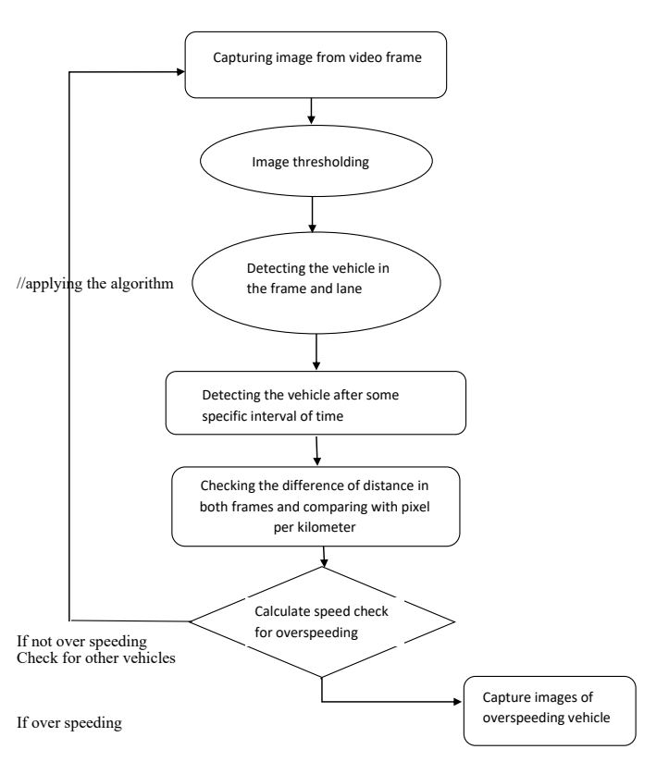
FLOWCHART

Slide 5

GITHUB COMMITS

Slide 6

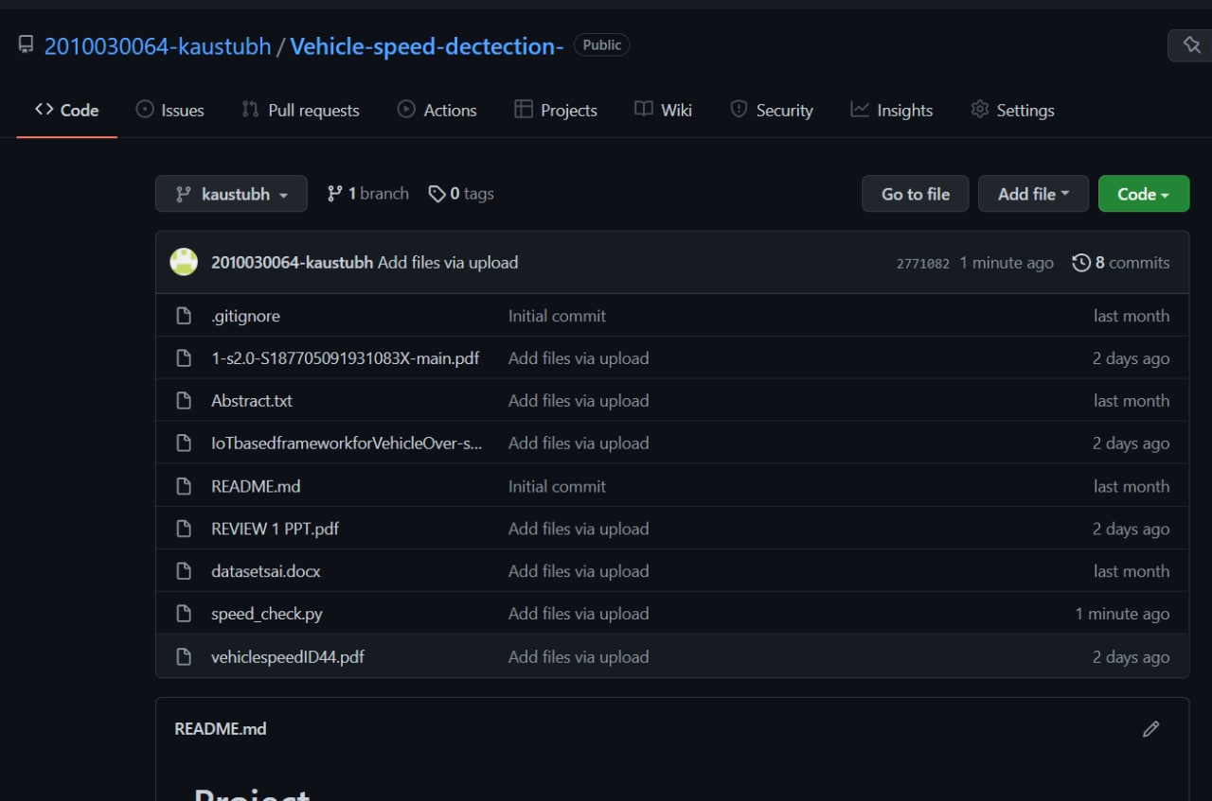
GITHUB COMMITS The link for the repository is https://github.com/2010030064-kaustubh/Vehicle-speed-dectection-

Slide 7



GITHUB COMMITS

Slide 8
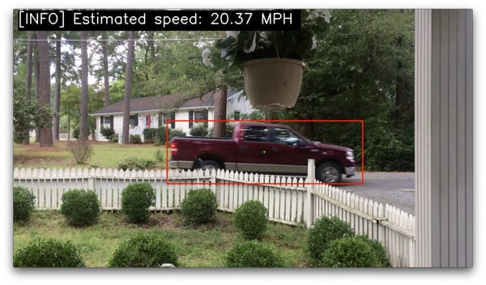
WORK PROGRESS

Slide 9
STEP-01-ARCHITECTURE OF PROJECT
WORK PROGRESS
We have finalized the workflow and design of the prototype of the selected concept, we have decided to break the process into 3 simpler steps 1-taking video as input
2-video processing (the system applies techniques such as frame masking )
3-detection of the vehicle movement within the parameters set
4-observation of the frames within the parameters range
5-the system then uses the concept of the timestamping and rate changes of the vehicle to determine the vehicle speed.
6-Calculations are performed to provide the vehicle speed.

Slide 10
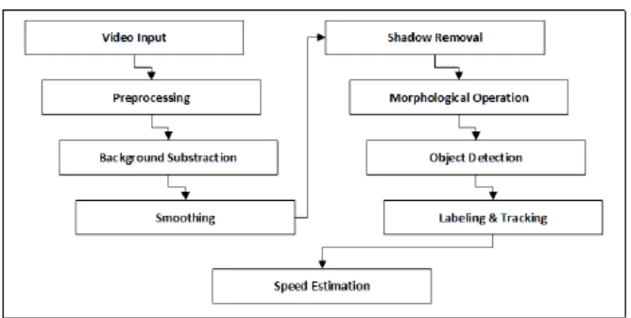
PRE-PROCESSING
Video data is extracted to frames and each frame is applied preprocessing before frame is being processed by background subtraction. Preprocessing is used to minimize bold shadow that can be detected as solid object which can decrease object detection accuracy.

Slide 11
STEP 02-DATASET WORKING
We have referred numerous research papers available online on the internet to find the required dataset for the requirement (references to the research papers are mentioned at the end).After thorough study ,we have finalized 3 datasets
KITTI It is one of the most popular datasets for use in mobile robotics and autonomous driving. It consists of hours of traffic scenarios recorded with a variety of sensor modalities.
The MS COCO (Microsoft Common Objects in Context) dataset Is a large-scale object detection, segmentation, key-point detection, and captioning dataset.
BRNOCOMPSPEED The dataset contains videos around captured at six different locations.
We have selected BRNOCOMPSPEED as the dataset for the project.

Slide 12
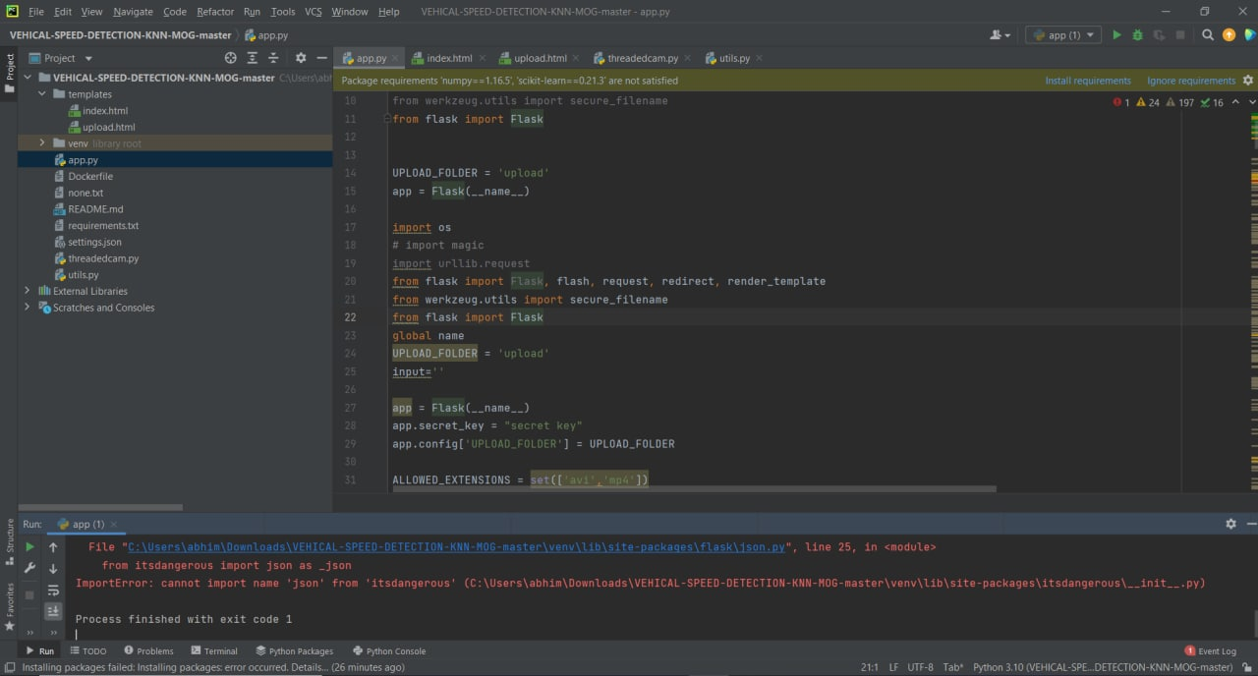
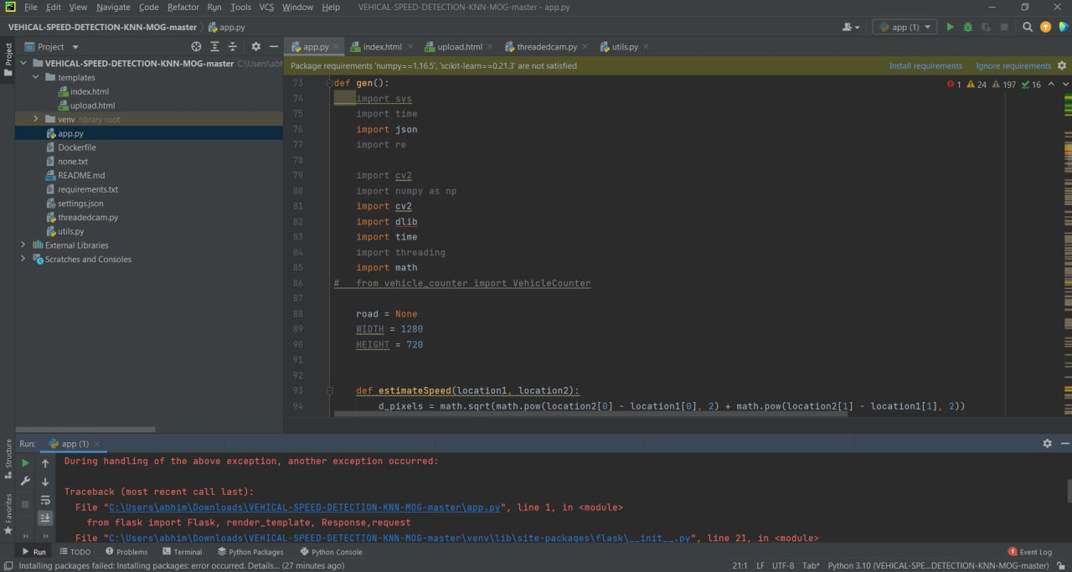
STEP 03-CODE PROGRESS
We have completed the code until some extent, but we have encountered numerous problems regarding the libraries and modules. We are still working on the completion of the code.

Slide 13
ALPHA TESTING
We have successfully run the program , the program developed will take input as a saved video and run it through the process to give the desired output i.e detection of speed of the objects in frame(angle of view).
We have encountered some errors in the output of the program. The program runs successfully in 99% of cases but in some cases where the object is moving too fast or there are multiple objects in frame the program encounters difficulty ,due to its large architectural process.
Also, since the program purely depends on the input file,if the input file doesn’t contain required number of pixelates (simple words clarity of the file),then the program might fail to identify the object in frame.

Slide 14
REFERENCES
[1] B. C. Putra, “Moving vehicle classiﬁcation with fuzzy logic basedon image processing,” Master’s thesis, Sepuluh Nopember Institute ofTechnology, 2016 [2] B. Setiyono, D. R. Sulistyaningrum, I. Mukhlash, and R. A. J. Firdaus, “Anew approach algorithm for counting of vehicles moving based on imageprocessing,” International Journal of Computer Science and InformationSecurity, vol. 14, no. 10, pp. 366–370, 2016
[3] A. G. Rad, A. Dehghani, and M. R. Karim, “Vehicle speed detectionin video image sequences using cvs method,” International Journal ofPhysical Sciences, vol. 5, no. 17, pp. 2555–2563, 2010
4] J. Lan, J. Li, G. Hu, B. Ran, and L. Wang, “Vehicle speed measurementbased on gray constraint optical ﬂow algorithm,” Optik-InternationalJournal for Light and Electron Optics, vol. 125, no. 1, pp. 289–295,2014.[5] H. Sundoro and A. Harjoko, “Vehicle counting and vehicle speed mea-surement based on video processing,” Journal of Theoretical and AppliedInformation Technology, vol. 84, no. 2, pp. 233–241, 2016

Slide 15
THANK YOU

